Slide 1
Clustering with K-means
SAHIL MANEKIA
https://github.com/sahilmanekia/kmeansNYC

Slide 2
About
Researcher with organizations in health and education
Program evaluator within healthcare and Ed [Teach for India]
Check out the Everyday Evaluation podcast
Stats at Columbia U– SIPA

Slide 3
Why K-means
Exploratory data analysis
Understanding patterns that may exist
Reduce complexity

Slide 4
Why K-means
K-means is an unsupervised learning method to discover patterns in data.
Particularly useful where information needs to be grouped without a knowledge of what those groups should be.

Slide 5
Quick Survey
Raise your hand if
You taken an intro stats class?
Can define what a centroid is?
Work with data or data analysis for a machine learning model?

Slide 6
What K Means Clustering is, and isn’t
It is an iterative algorithm
It is meant to be used for quantitative variables – it takes that input and outputs categories or a cluster
Not a measure of truth or relationship
Can vary based on starting point of the algorithm

Slide 7
Using K-means to solve a problem
Healthcare has a lot of data on members or patients
Expensive patients tend to have multiple chronic conditions
Knowing the mix of groups and conditions can have implications for staff training and cost control
The unsupervised learning task is to classify patients into closely related groups based on the information available

Slide 8
We have some data for this exercise
Patients from i…to…N
Episodes – we have information on each diagnosis received and classify series as an episode if it is all generated from the same claim
We are only using continuous not categorical or binned data
Certain conditions generate more episodes than others. To assign equal weight we standardize

Slide 9
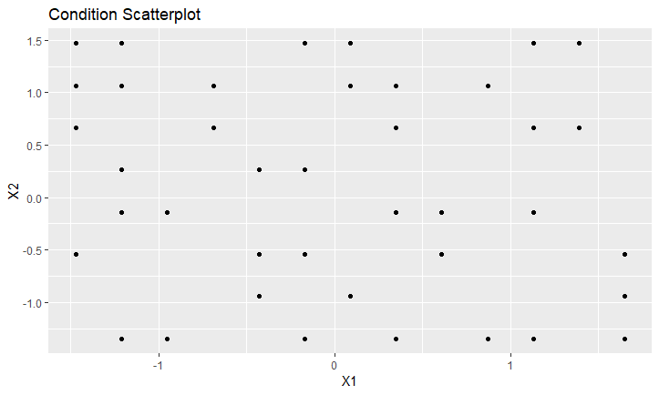

Slide 10
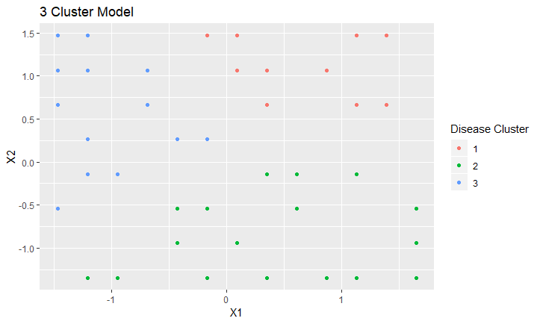

Slide 11
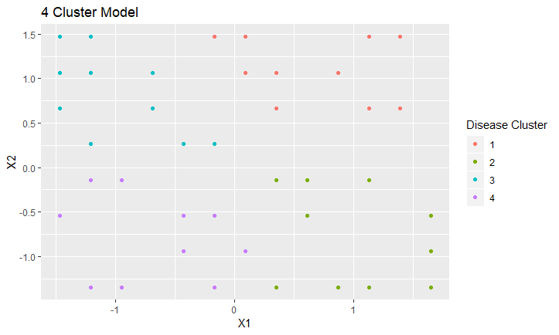

Slide 12
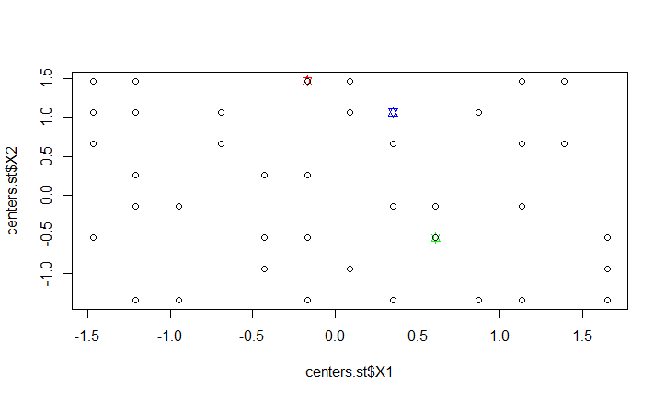

Slide 13
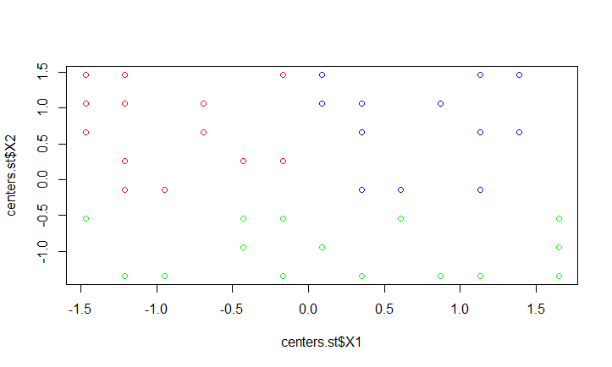

Slide 14
Centroids
The Centroid of a cluster is a collection of feature values which define the resulting groups.
It is created by averaging across all of the values that are assigned to it
Once the new centroids are created the points are reassigned

Slide 16
Updating
Points are reassigned based on the position of the new centroid
The assignment is based on minimizing the squared Euclidean distance between the points and the centroid
More formally, if Ci is the collection of centroids in set C, then each data point x is assigned to a cluster based on
argmin dist(Ci,x)^2

Slide 17
Convergence
The algorithm converges when no points change their group membership after the new centroids are created.
The algorithms will keep cycling through the updating->mean calculation-> updating process until the change in variance is minimal
The data points at the center of the cluster are also known as prototypes

Slide 18
Convergence Math
Training Set {1.2, 5.6, 3.7, 0.6, 0.1, 2.6}
Randomly pick centroids as 2, and 5
Adapted: www.stat.psu.edu/~jiali
Fixed | Update
2 5 | {1.2,0.6,0.1,2.6} {5.6, 3.7}
{1.2, 0.6, 0.1, 2.6} {5.6, 3.7} | 1.125 4.65
1.125 4.65 | {1.2, 0.6, 0.1, 2.6} {5.6, 3.7

Slide 19
Choosing K
K refers to the number of clusters you ask the algorithm to find
There is generally no perfect way, so you try different values of K
Assigning more K will fill the feature space and so you will keep minimizing the within cluster variance. Therefore that is not the best measure.
Instead, mean distance to the centroid as a function of K is plotted and the "elbow point," where the rate of decrease sharply shifts, can be used to roughly determine K.

Slide 20
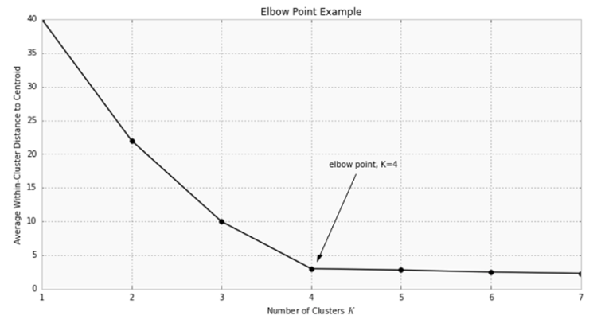
Choosing K

Slide 21
Problems with binaries and categorical data

Slide 22
Using binary and categorical data
Apply transformations to the data so that it is distributed
Principal components or factor analysis

Slide 23
Bringing it all together

